Slide 1
SAP HANA High Availability & Disaster Recovery

Slide 2
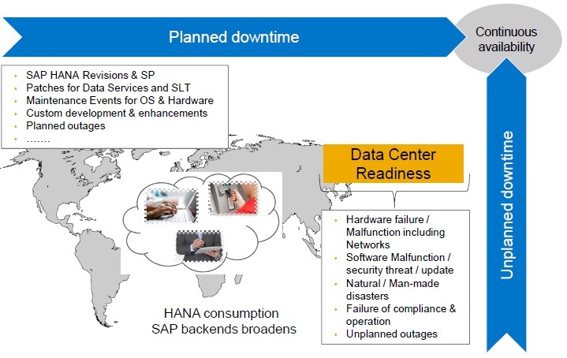
SAP HANA Continuous Availability Customer Expectation: Planned & Unplanned

Slide 3
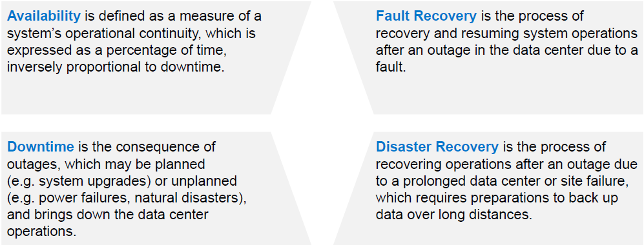
What is high availability?

Slide 4
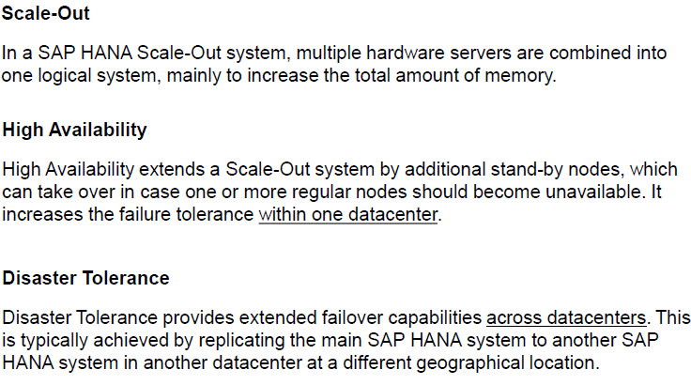
SAP HANA Scale-Out, High Availability & Disaster Tolerance

Slide 5
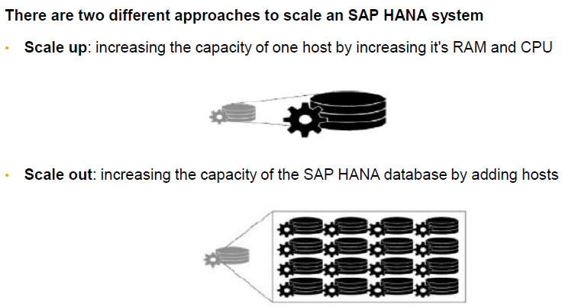
SAP HANA Scaling

Slide 6
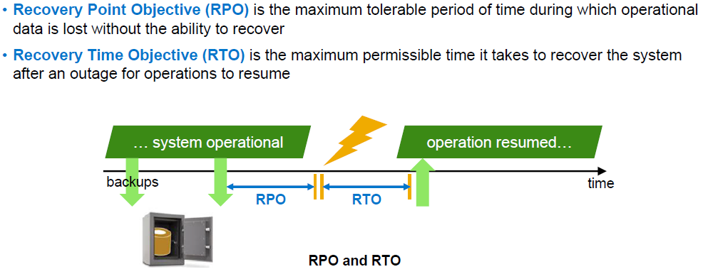
Recovery – key performance indicators

Slide 7
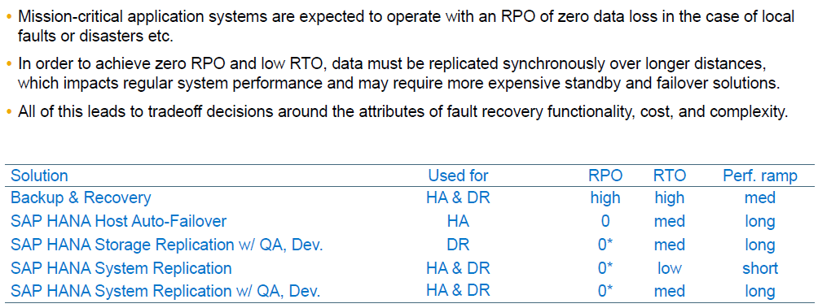

Slide 8
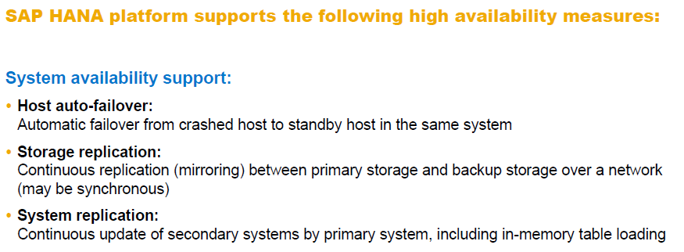

Slide 9
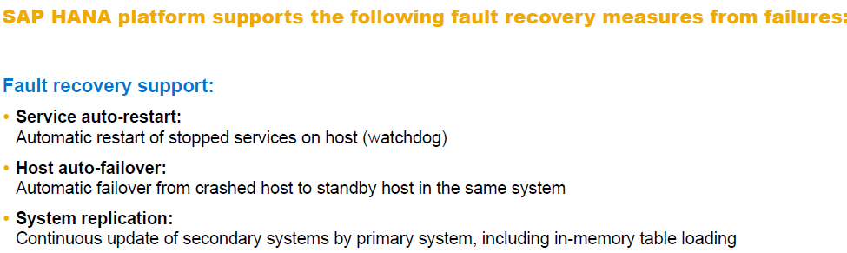

Slide 10
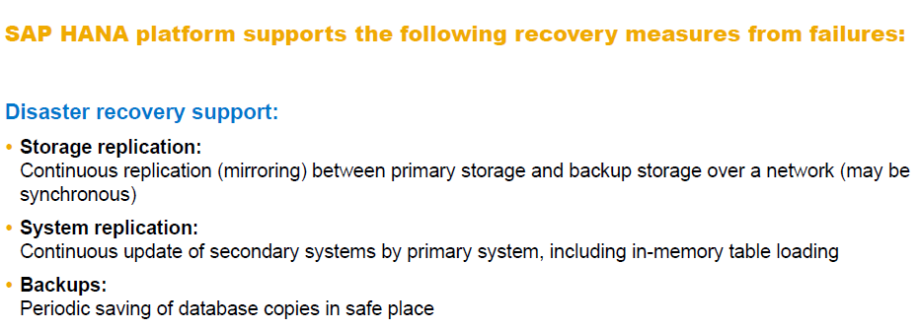

Slide 11
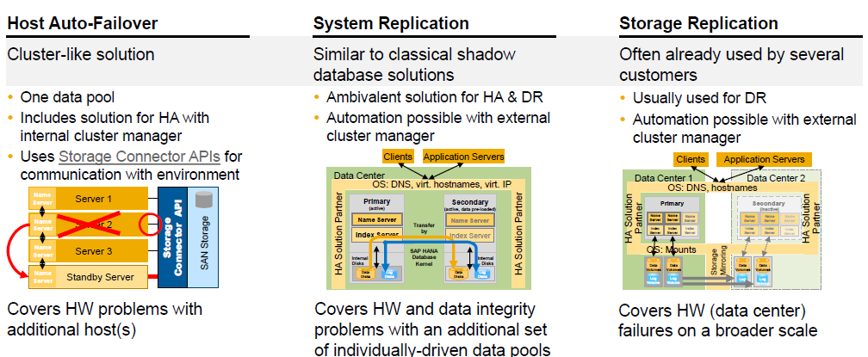
High Availability, Backup, and Disaster Recovery – Setup Options

Slide 12
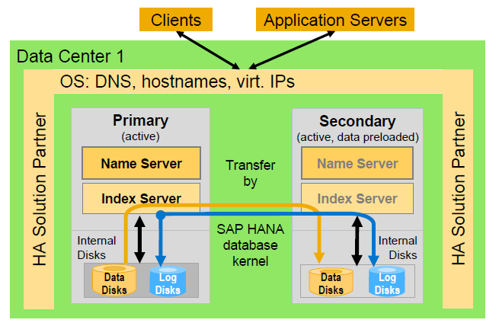

Slide 13
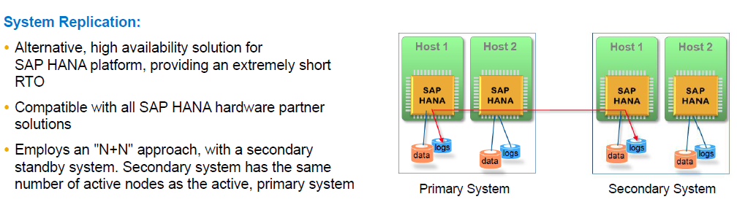
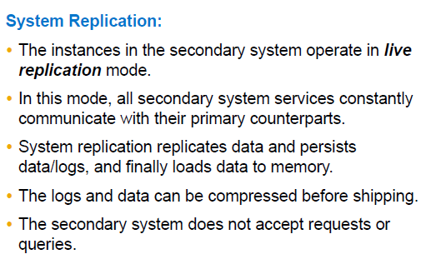
System Replication

Slide 14
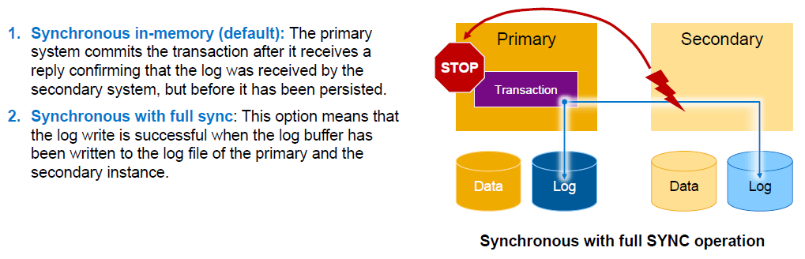
Replication mode

Slide 15
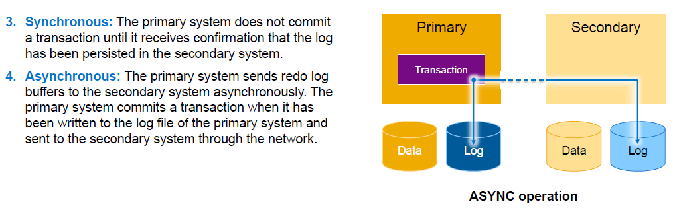

Slide 16
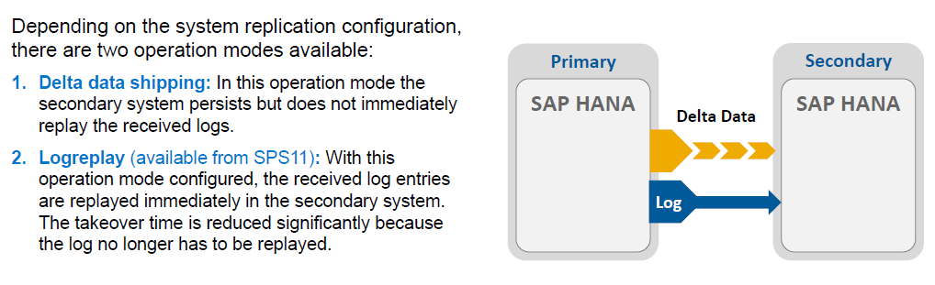
Operation mode – Options

Slide 17
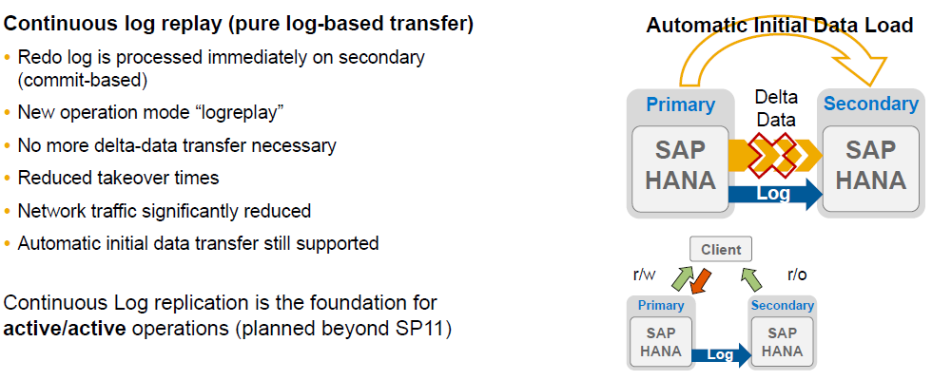
Continuous Log Replay Replication

Slide 18
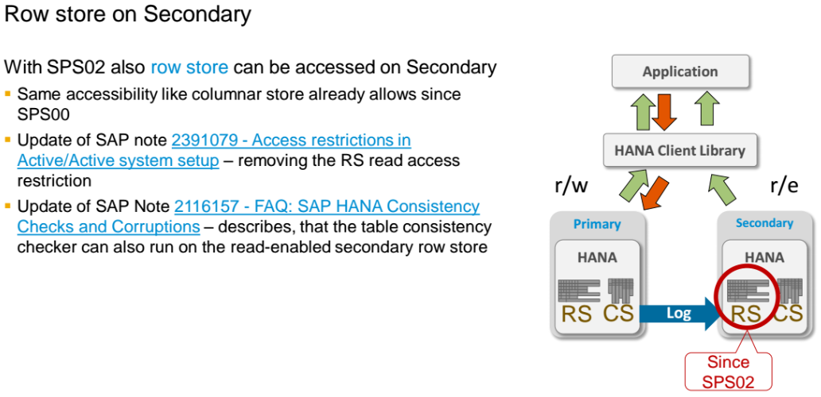
HANA 2.0 SPS02: Active/Active read-enabled

Slide 19
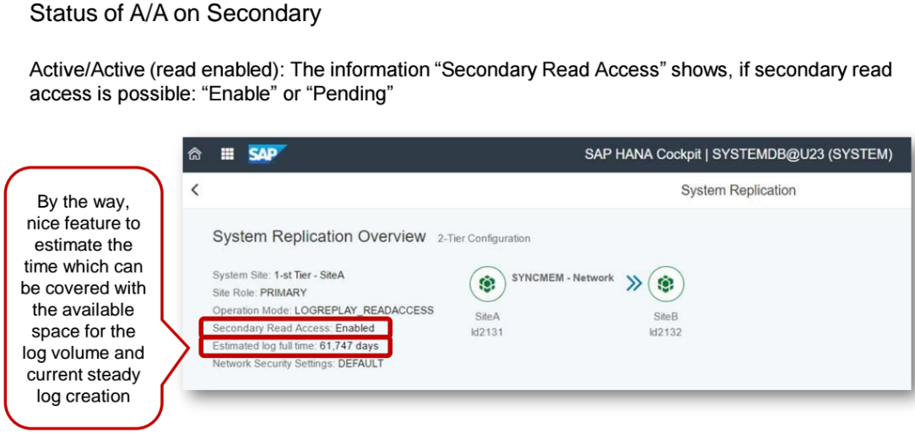
HANA 2.0 SPS02: Active/Active Cockpit

Slide 20
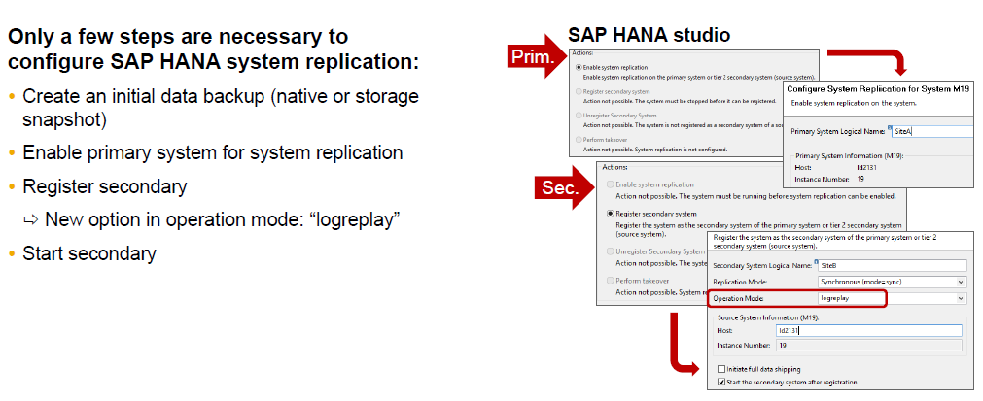

Slide 21
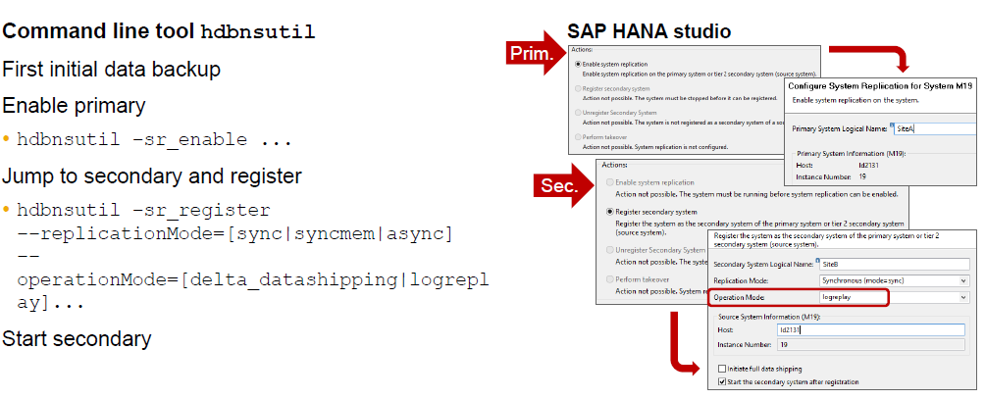

Slide 22
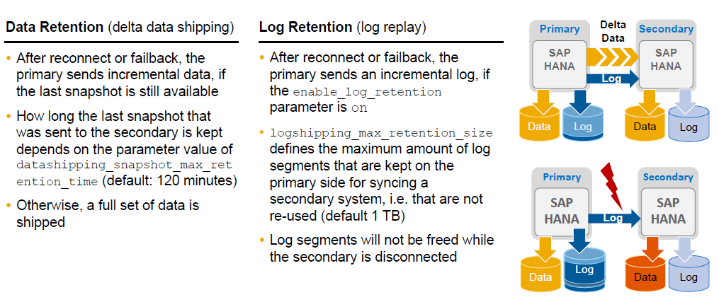
Data retention vs. log retention

Slide 23
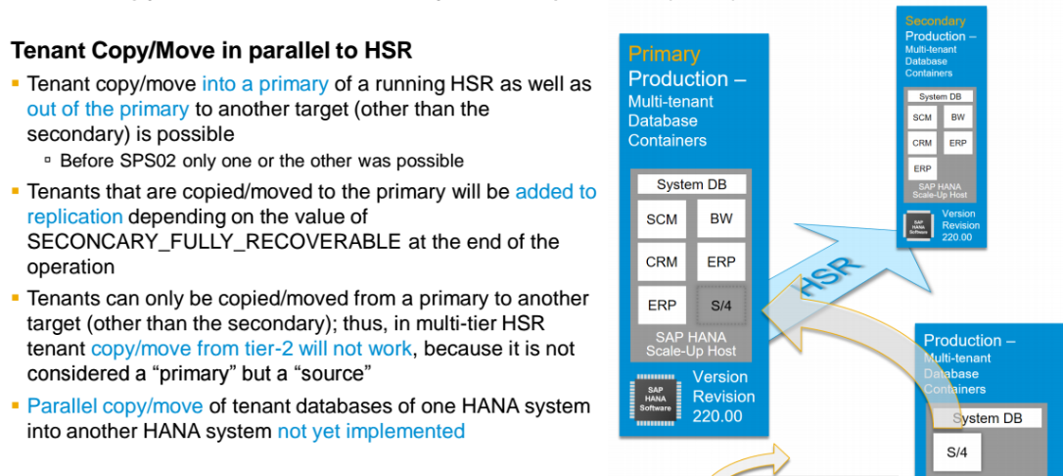
Tenant copy/move & SAP HANA System Replication

Slide 24
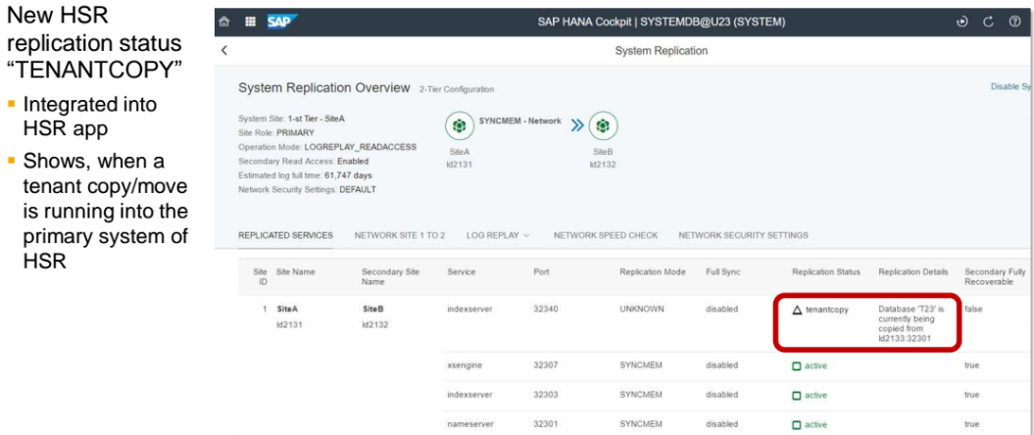
HSR Replication Status “TENANTCOPY”

